Slide 1

Stewardship
Ministries
Resources
https://stewardship.adventist.org/resources
by Johnetta B. Flomo

Slide 2




Four Category of Resources
01 Periodicals
02 Stewardship
Training
03 Promotional
04 General

Slide 3
Four Category of Resources
01 Periodicals

Slide 4
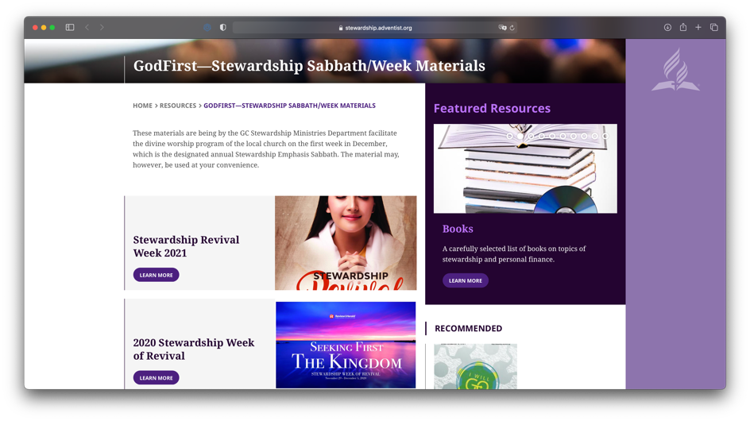
Periodicals
Annual
Stewardship Revival
Week—God First
1st Sabbath in December is Stewardship Emphasis day. The week prior is the Stewardship Revival Week.
https://stewardship.adventist.org/stewardship-revival-week-2021

Slide 5
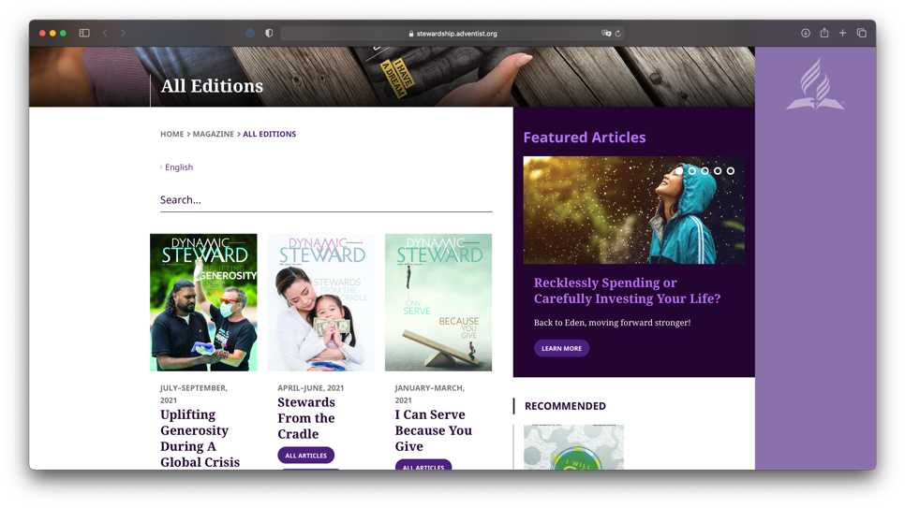
Periodicals
Quarterly
Dynamic Steward
Magazine
(Available in 4 languages)
https://stewardship.adventist.org/issue-archive

Slide 6
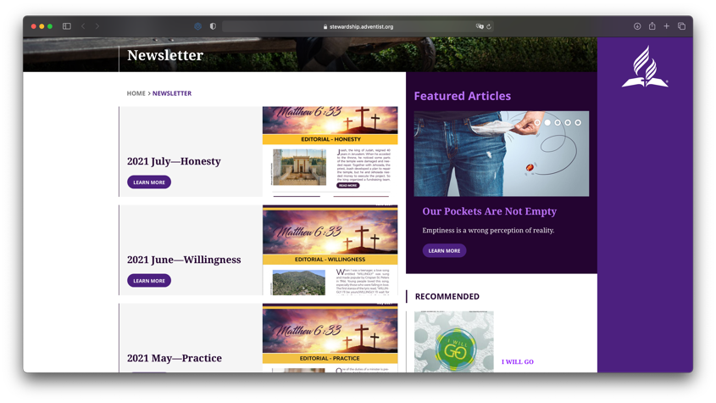
Periodicals
Monthy
God First
Newsletter
https://stewardship.adventist.org/newsletter

Slide 7
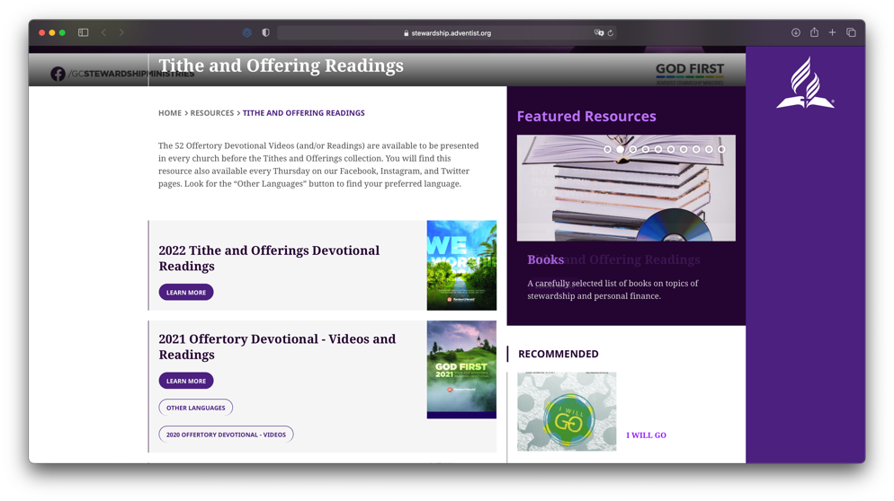
Periodicals
Weekly
Tithe and Offerings
Devotional Readings
https://stewardship.adventist.org/tithe-and-offerings-readings

Slide 8
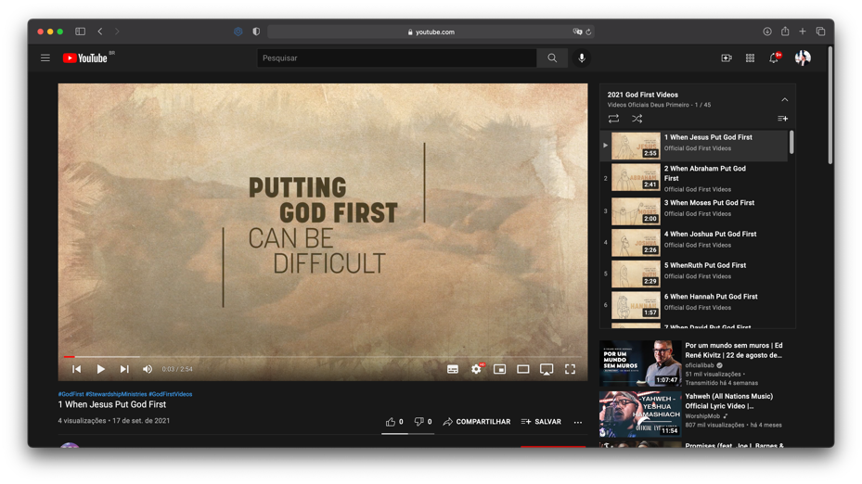
Periodicals
Weekly
Tithe and Offerings
Devotional Videos
(Available in over eight languages)
https://stewardship.adventist.org/other-languages
https://vimeo.com/user10937457/collections
https://www.youtube.com/channel/UCMzCjsCnUpJSUJVd02qRwtw/playlists

Slide 9
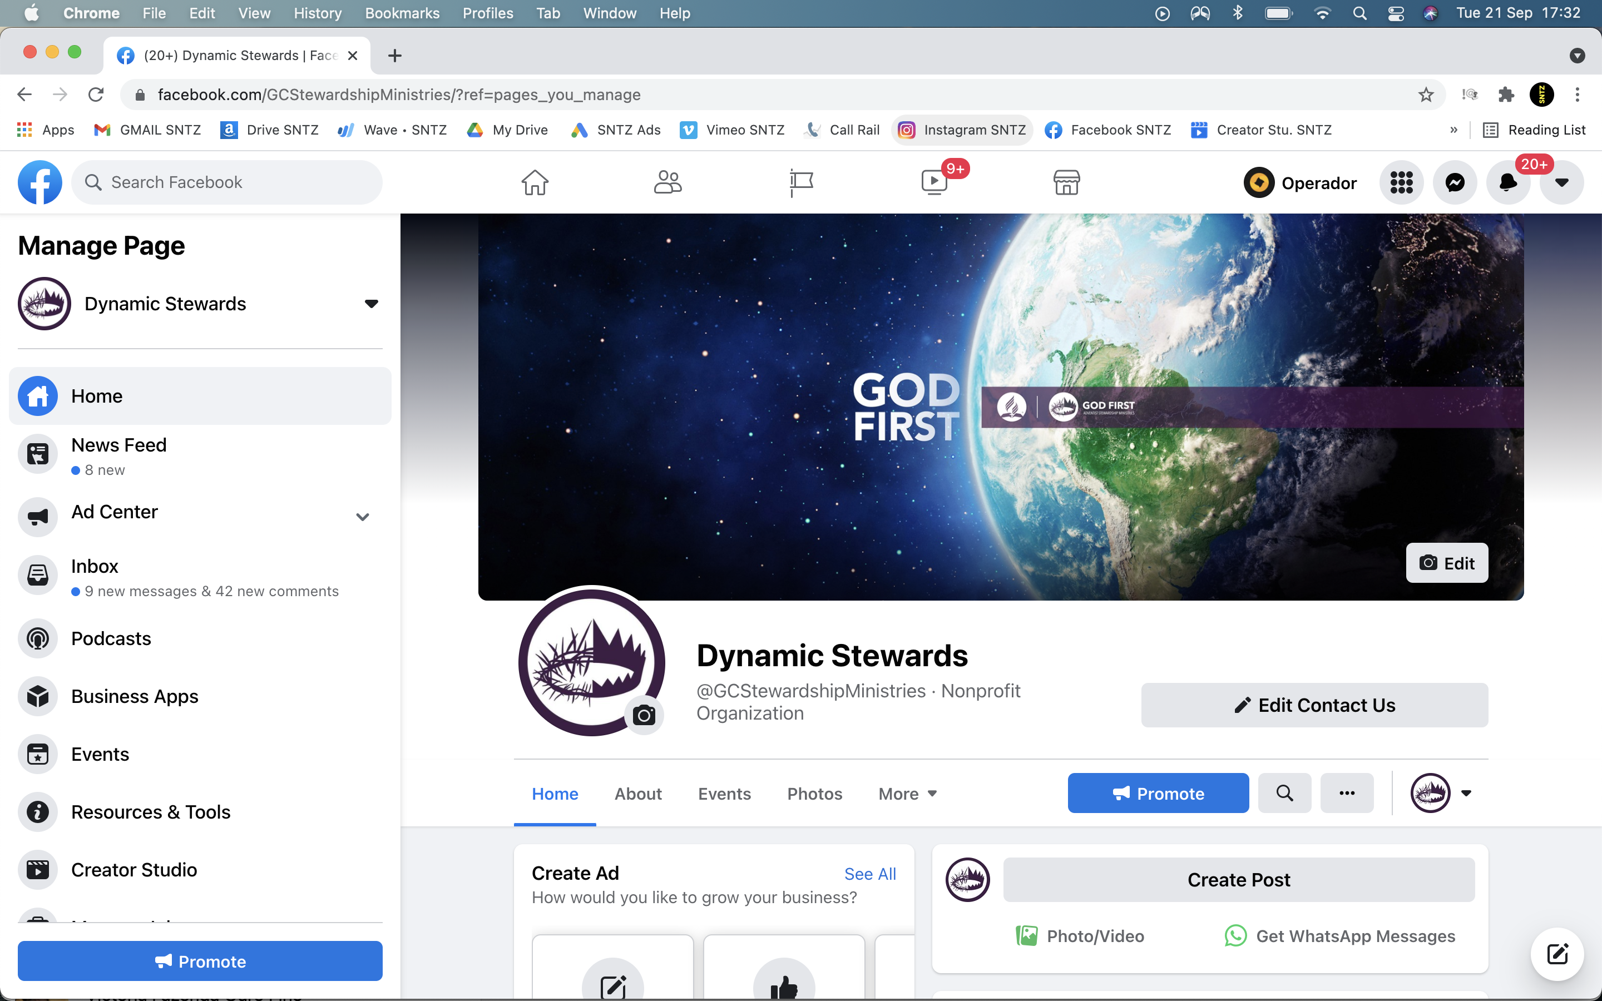
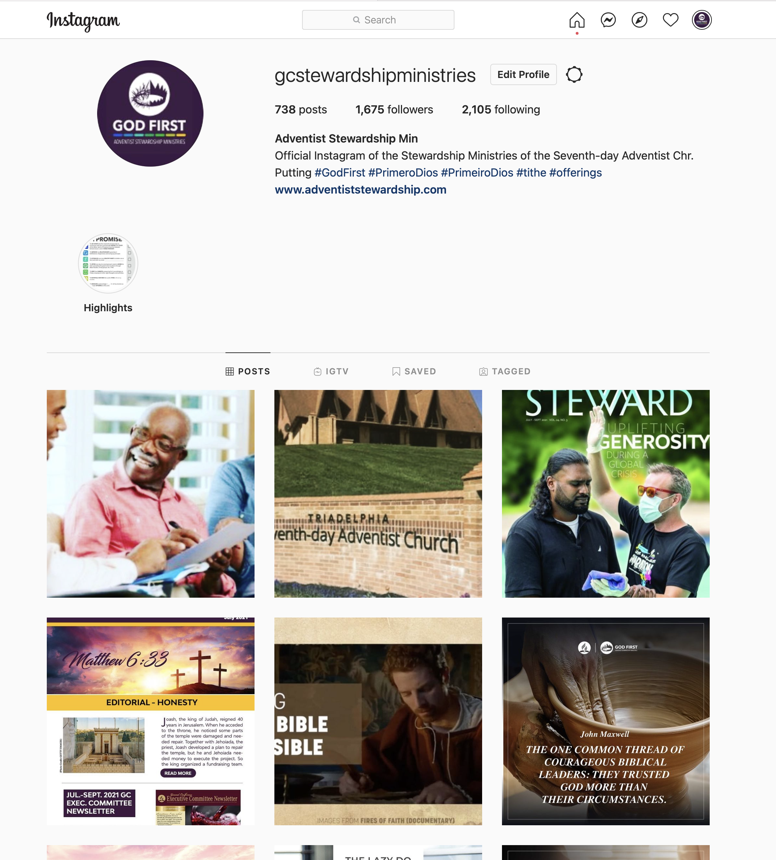
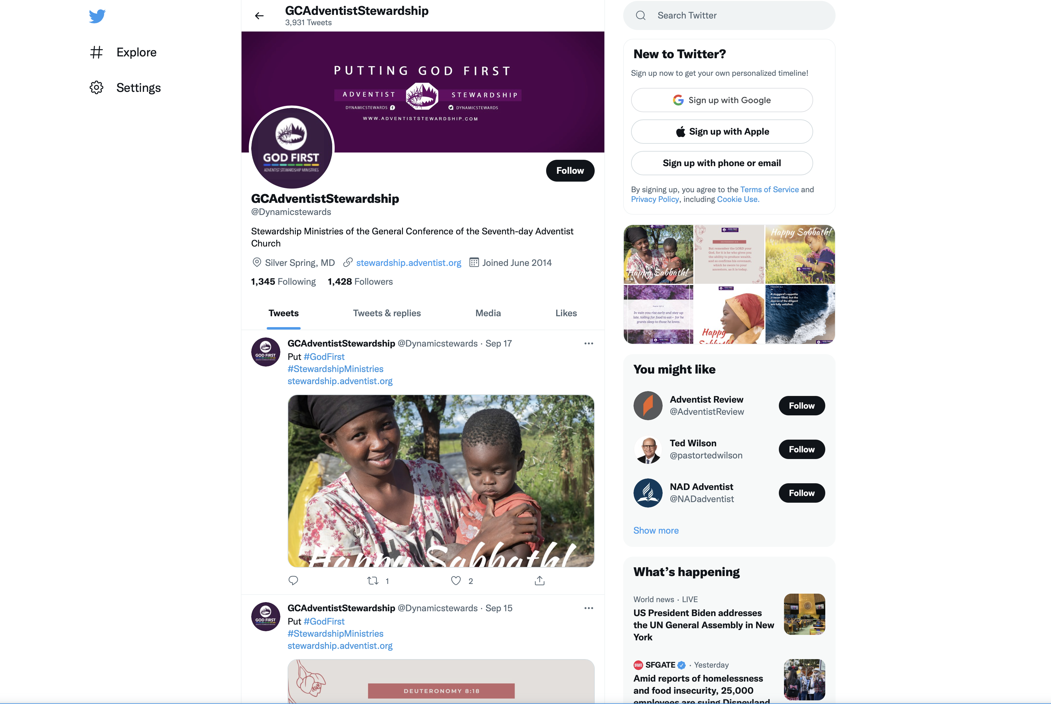
Periodicals
Daily
Postings
Facebook, Twitter and Instagram
https://www.facebook.com/GCStewardshipMinistries/
https://twitter.com/dynamicstewards
https://www.instagram.com/gcstewardshipministries/

Slide 10
Four Category of Resources
02 Stewardship Training

Slide 11
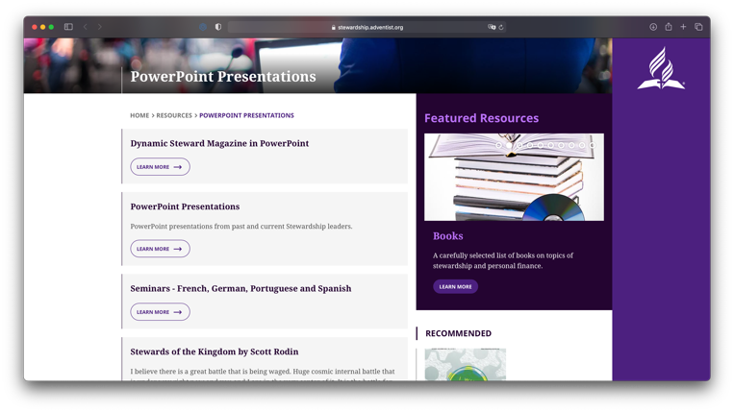
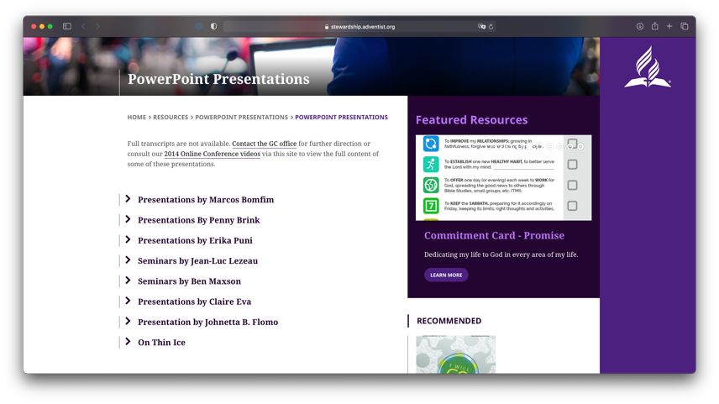
Stewardship Training
PowerPoint
Presentations
https://stewardship.adventist.org/presentations
Current and
Past Leaders
https://stewardship.adventist.org/powerpoint-presentations

Slide 12
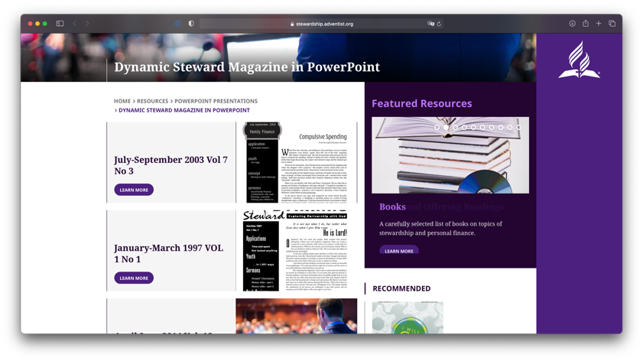
Stewardship Training
PowerPoint
Presentations
Dynamic Steward
Magazine
https://stewardship.adventist.org/dynamic-steward-in-powerpoint

Slide 13
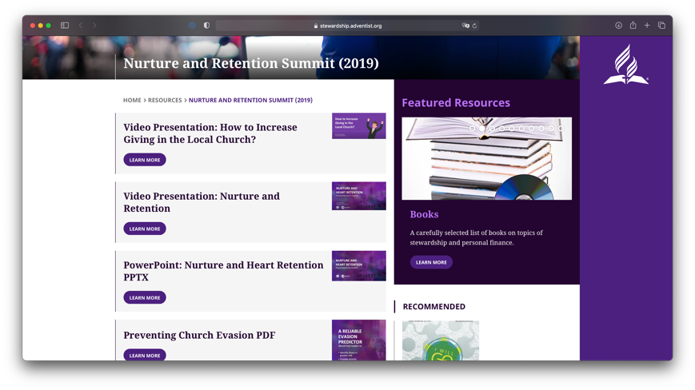
Stewardship Training
Nurture and
Retention
https://stewardship.adventist.org/2019-nurture-and-retention-summit

Slide 14
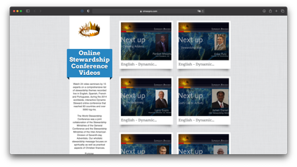
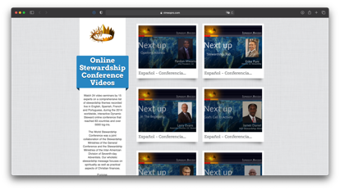
Stewardship Training
Online Stewardship Video Series
https://vimeopro.com/user10937457/online-stewardship-conference-videos/page/1
https://vimeopro.com/user10937457/online-stewardship-conference-videos/page/5
English
Spanish

Slide 15

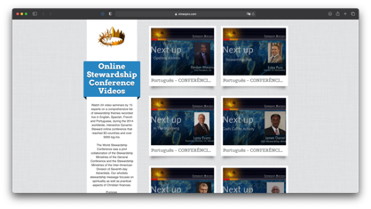
Stewardship Training
Online Stewardship Video Series
https://vimeopro.com/user10937457/online-stewardship-conference-videos/page/9
French
Portuguese
https://vimeopro.com/user10937457/online-stewardship-conference-videos/page/13

Slide 16
Four Category of Resources
03 Promotional

Slide 17


Promotional Resources
Brochures
Promise Brochure
https://stewardship.adventist.org/promise-brochure.pdf

Slide 18
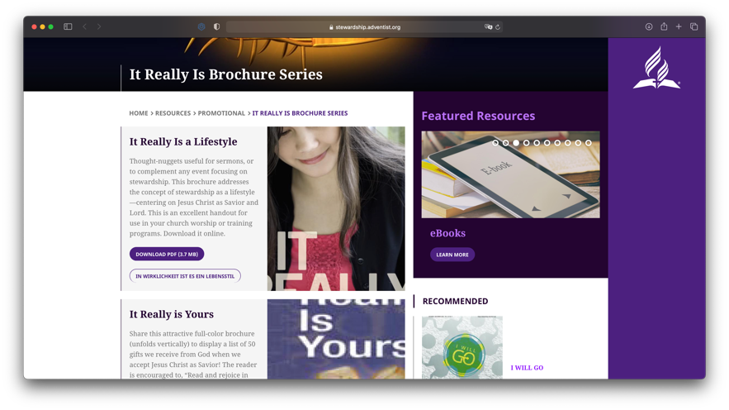
Promotional Resources
Brochures
It Really Is Series
https://stewardship.adventist.org/it-really-is-brochure-series

Slide 19

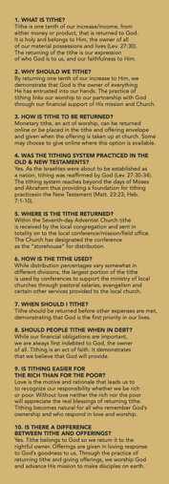
Promotional Resources
Bookmarks
Ten Tithing
Questions Answered
https://stewardship.adventist.org/bookmarks.pdf

Slide 20
Four Category of Resources
04 General

Slide 21
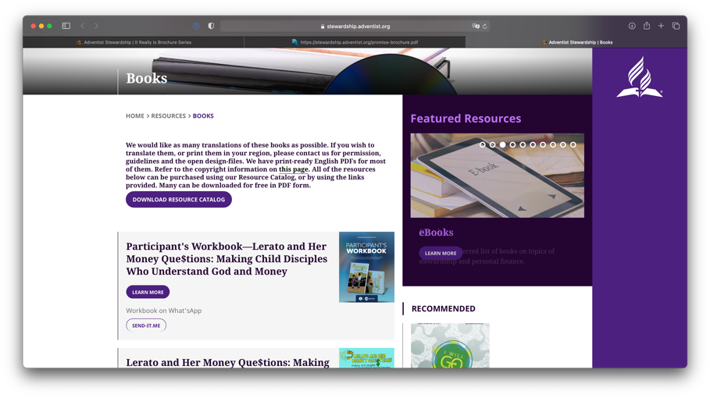
General Resources
Books
https://stewardship.adventist.org/books

Slide 22
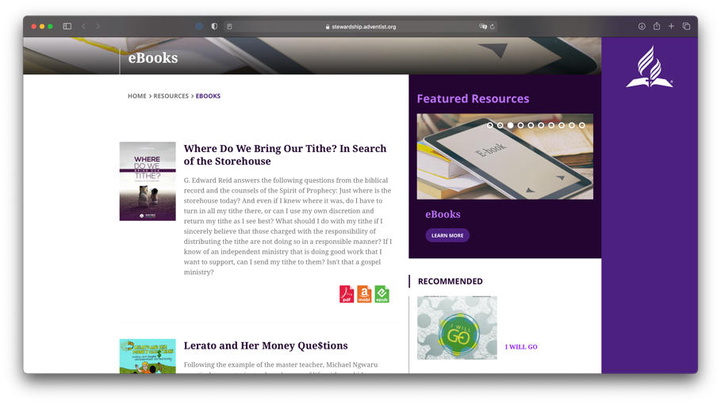
General Resources
e-Books
https://stewardship.adventist.org/ebooks

Slide 23
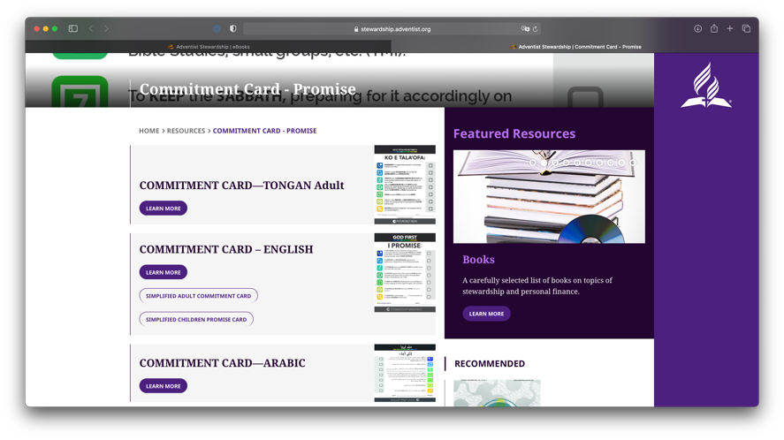
General Resources
Commitment
Cards
(Available in 23 languages)
https://stewardship.adventist.org/commitment-card-promise

Slide 24
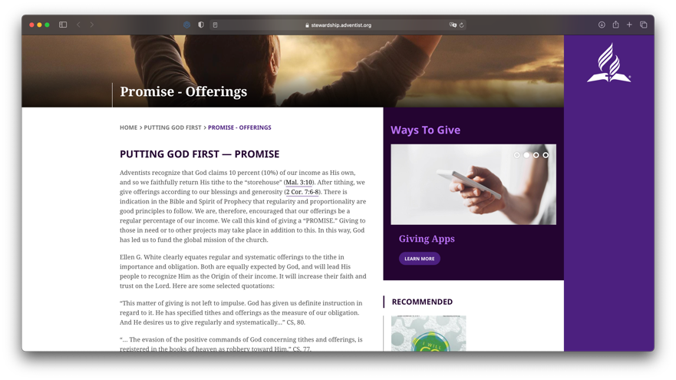
General Resources
Information
on Promise,
percentage-based
offering
https://stewardship.adventist.org/promise-offerings

Slide 25
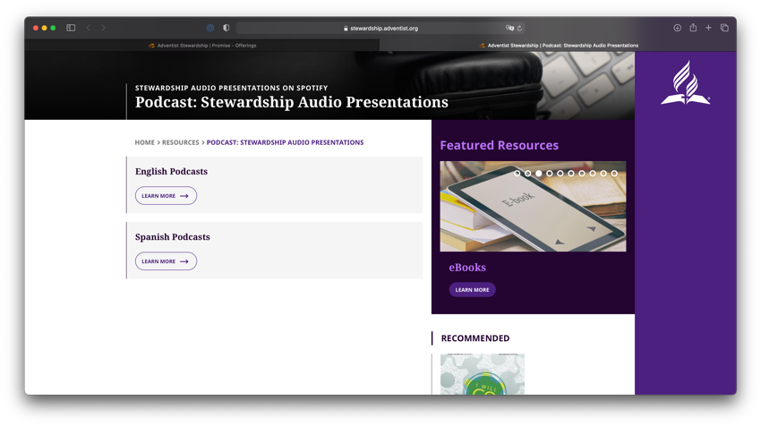
General Resources
Podcasts
(Available in English and Spanish)
https://stewardship.adventist.org/podcast-stewardship-audio-presentations

Slide 26
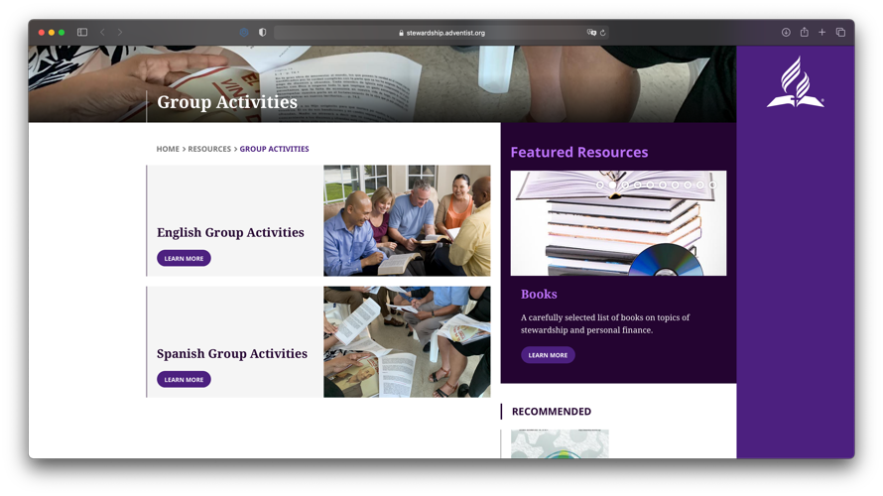
General Resources
Group
Activities
(Available in English and Spanish)
https://stewardship.adventist.org/activity-brochures

Slide 27
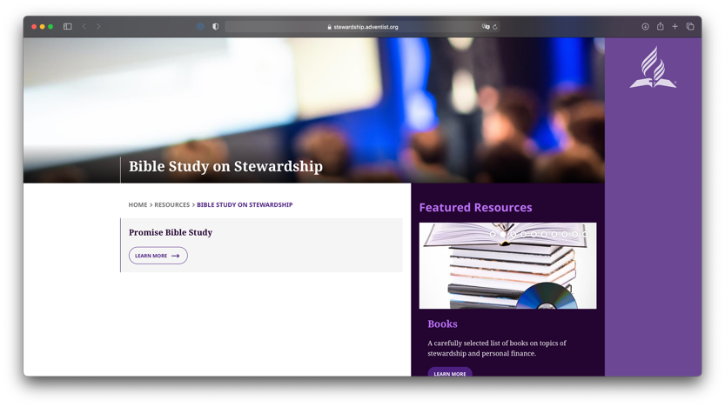
General Resources
Bible
Study on
Stewardship
(PDF)
https://stewardship.adventist.org/bible-study-on-stewardship

Slide 28

Departmental Access
for directors only
On stewardship website under About Us.
https://stewardship.adventist.org/page732
Username: director Password: advisory2017

